Slide 1
PROJECT PHASE

Slide 2
CONTENT
OBJECTIVE
POWER BI

Slide 3
Objective
The objective of this project is to assess and select tools from our existing platforms, Time-O-Clock Plus and Netchex. Subsequently, we aim to design and implement a Business Intelligence (BI) solution that allows for monthly data input. This BI system will facilitate efficient data tracking and measurement, enabling data-informed decision-making and performance enhancement.
However, since I am not able to get access to the platform dataset, We will therefore use a sample dataset generated for this project.

Slide 4
Generating Dataset.
In generating a dataset using ChatGPT involves defining the dataset format, interacting with the model to request data generation, reviewing and refining the generated responses, ensuring data quality, and extracting structured data. The process includes defining the format, iterating as needed, and converting the generated data into the desired format.
Reviewing the data to make sure that all the required fields are generate and that the ethical and privacy aspects are essential to produce a reliable dataset for your intended use.

Slide 5

Power BI software
Power BI is a powerful business intelligence tool that allows organizations to extract valuable insights from their data.
With its capabilities for data visualization, real-time reporting, data, integration, and customization, it provides a cost-effective solution for businesses to analyze data, make informed decisions, and foster growth.
Additionally, its AI integration enhances predictive analytics, making it a comprehensive platform for deriving meaningful insights and achieving data-driven success.

Slide 6
Develop a BI solution for data tracking and measurement
In other to develop a Power BI tracking and measurement system to gain insight about the business goals. We need to identify the various metric that will be used in achieving the goal of the company. The following steps will be taking;
Set Up a Monthly Data Input: create a folder on your system that allows you to input data each month, ensuring consistency and reducing manual work.
Visualize Your Data: Creating a dashboard in Power BI with visualizations, using the identified matric using the data received to create charts, graphs, and tables in a way that's easy to understand and save it in the folder created for monthly data input.
Leverage Data Insights: Using the dashboard's data to make informed decisions and identify areas for improvement, ultimately boosting business performance and reporting.

Slide 7
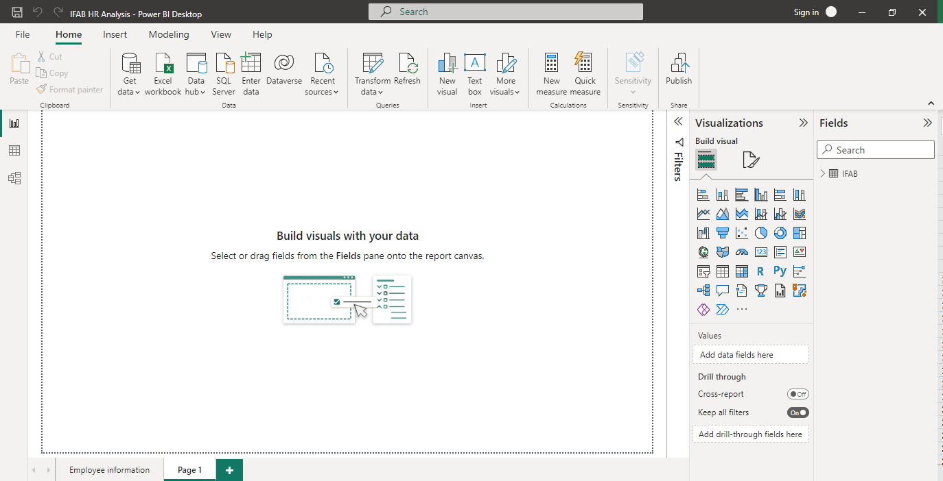
POWER BI INTERFACE
The followings are the ribbons used in Power Bi interface and their functions:
Home: This ribbon provides options for opening, saving, publishing, and exporting reports, as well as creating new reports and connecting to data sources.
Insert: You can use this ribbon to insert various elements into your report, such as visuals, text boxes, shapes, and buttons.
Modeling: The Modeling ribbon contains tools for managing relationships between data tables, creating calculated columns and measures, and editing data properties.
View: This ribbon allows you to control the view of your report, including options for zooming, gridlines, and Rulers.
Data: The Data ribbon provides access to Power Query, where you can transform and shape your data before using it in your report.
Help: This ribbon includes links to documentation, community support, and feedback options for Power BI.

Slide 8
ExcelSheet to PowerBI
Moving a dataset from Excel to Power BI involves the process of importing data from an Excel spreadsheet into Power BI for analysis, visualization, and reporting.
This transition allows us to take advantage of Power BI's powerful features, such as creating interactive dashboards, generating insightful reports, and leveraging data modeling capabilities. Typically, this is done by connecting to the Excel file, selecting the desired tables or data ranges, and transforming the data as needed within Power BI to create meaningful visualizations and analyses.
We'll keep the Excel sheet open on our desktop because from time to time, we need to generate new columns by converting certain qualitative data records into quantitative data. Once we create these columns, we save the changes in the Excel sheet and then refresh both the Excel file and Power BI. This ensures that the new column becomes visible in Power BI. The next slide provides a visual overview of this process.

Slide 9
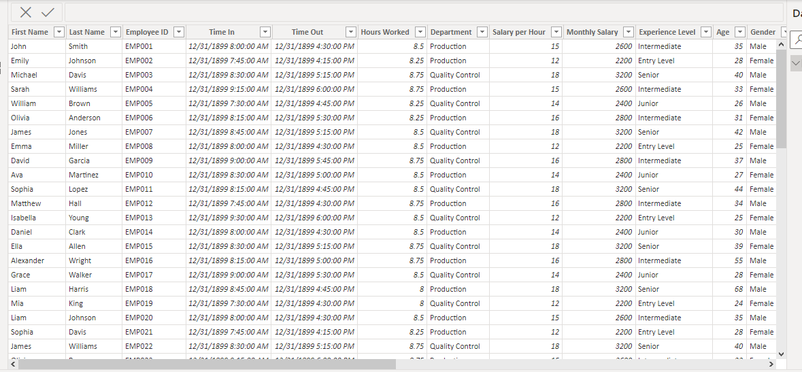

Slide 10
Practical Work on Power BI
Since I was not able to access the company data, I derived a sample dataset that will be used in gaining insight. Also, the following questions will be answered using the sample dataset:
Questions:
Trends in the Company: create a Power BI dashboard that shows the turnover rate of employees in different departments over the past year, highlighting any trends or patterns.
Performance Appraisal: "Develop a Power BI dashboard that visualizes employee performance appraisal results. Include visualizations that highlight the distribution of performance ratings across departments, allowing for easy comparison and identification of underperforming areas."
Employee Satisfaction and Engagement: "Create a Power BI dashboard that visualizes employee survey responses related to job satisfaction and engagement.
Diversity and Inclusion: "Using Power BI, analyze and visualize workforce diversity data, showing the distribution of employees across gender and age. Include metrics on diversity ratios and visualize progress towards diversity and inclusion goals."

Slide 11
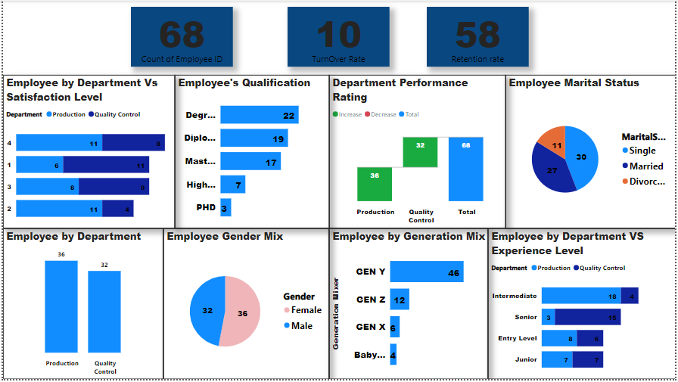
Visualization of the solutions above

Slide 12
Explaining each graph and what question it answer:
Questions:
Trends in the Company: create a Power BI dashboard that shows the turnover rate of employees in different departments over the past year, highlighting any trends or patterns.
Why? To Provide actionable insights that can lead to improved employee retention, resource allocation, and strategic HR planning, all of which contribute to a healthier and more productive work environment.
The next three slides will show the number of employee in the company, the turnover rate and the retention rate.

Slide 13
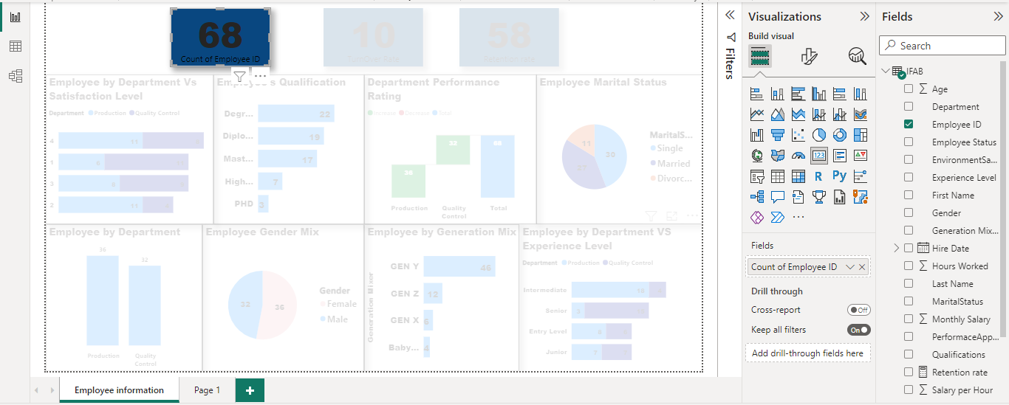
Number of Employee
How to plot the graph:
To get the Employee ID count:
From the visualization tool we choose a report card.
On the field section, click the IFAB to dropdown all the columns in the dataset.
Drag the employee ID fields into the “values” area under the Visualization pane.
Once you do that, by default powerBI often sum the value but we will choose the count.
We can now drag the employee ID into the report card and format it to suit you.

Slide 14
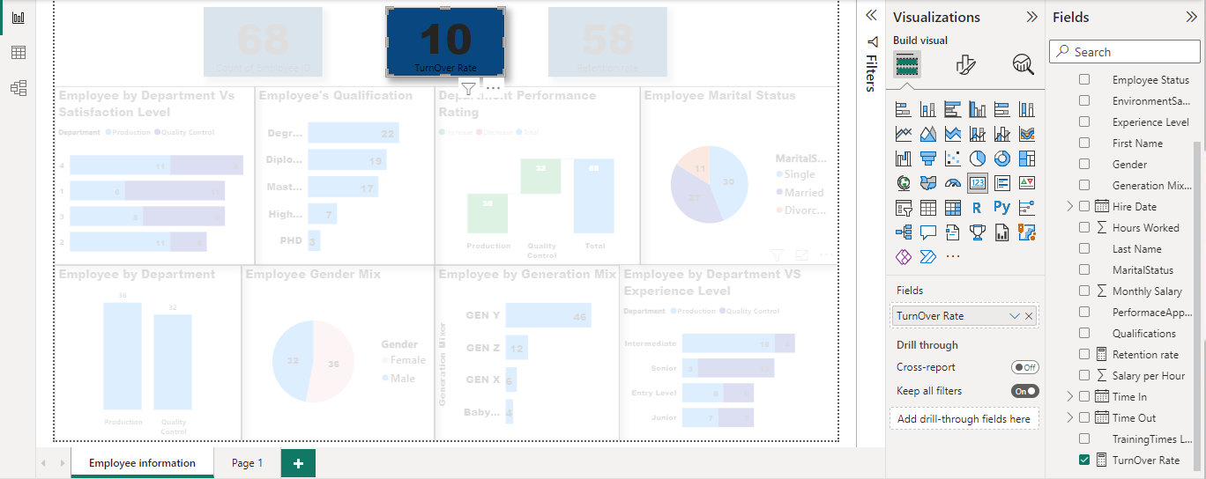
Turnover-Rate
To get the Turnover rate :
Go to your excel work sheet and insert a new column, apply IF Statement on the new column referencing the Hire date and offboarding data. The new column will be called the Employee Status, with values of in-house and exited, Save and refresh.
On IFAB Field, click the three dot and select refresh .Once this is down, stroll down to find the employee status.
Click on the employee status, right click and choose new measure, this is in other to apply the formular for calculating the turnover rate. A box pops out and you click on the filter values.
Select the Employee ID to be the Numerator and exited as the denominator, then click ok. The new measure will be saved as Turnover Rate.
Drag the Turnover rate into the “values” area under the Visualization pane.
We can now drag the Turnover rate into the report card and format it to suit you.

Slide 15
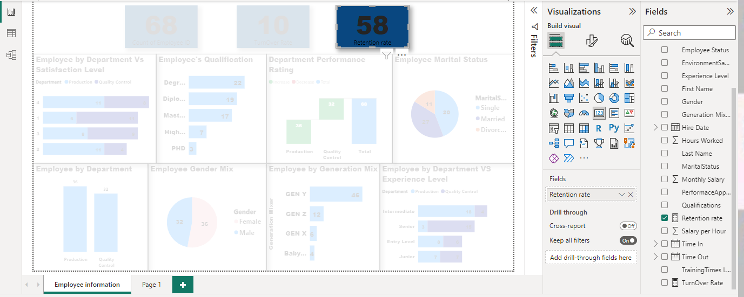
Retention Rate
Click on the employee status, right click and choose new measure, this is in other to apply the formular for calculating the retention rate. A box pops out and you click on the filter values.
Select the Employee ID to be the Numerator and In house as the denominator, then click ok. The new measure will be saved as Retention Rate.
Drag the Retention rate into the “values” area under the Visualization pane.
We can now drag the Retention rate into the report card and format it to suit you.

Slide 16
Explaining each graph and what question it answer:
Questions:
Performance Appraisal: "Develop a Power BI dashboard that visualizes employee performance appraisal results. Employee Satisfaction and Engagement: "Create a Power BI dashboard that visualizes employee survey responses related to job satisfaction and engagement
Why? A Power BI dashboard for performance appraisal and employee survey responses is designed to enhance decision-making by providing visual insights into both performance ratings and employee satisfaction across departments. This aids in identifying underperforming areas and addressing issues related to job satisfaction and engagement for a more efficient and productive workforce.
The next three slides will show the visualization of the question ask.

Slide 17
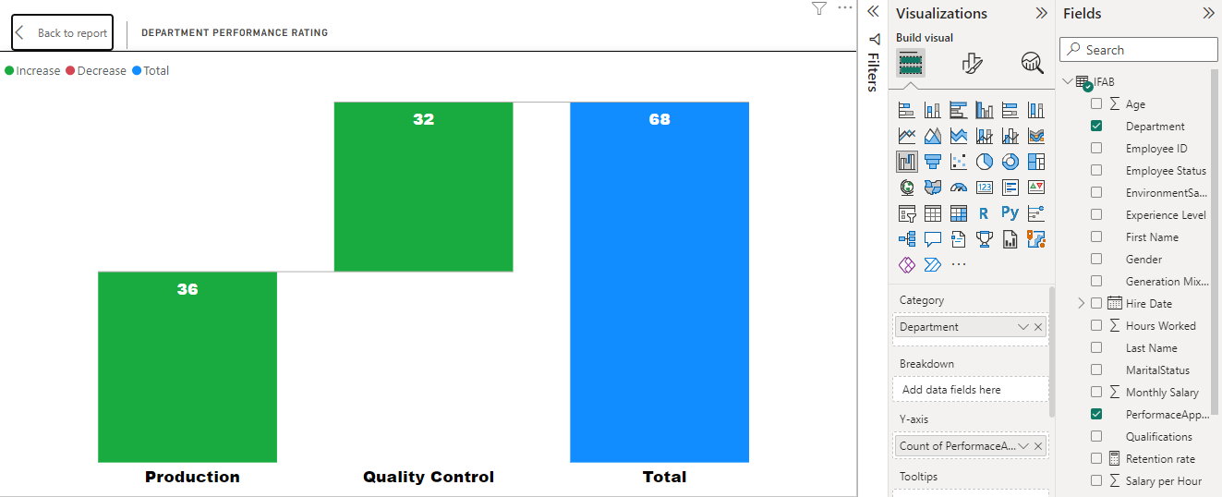
Departments Performance Rating
How we go this graph:
From the visualization tool we choose a KPI bar chart.
On the field section, click the IFAB to dropdown all the columns in the dataset.
Drag the Department fields to the Category, Count of PerformanceAppraisal Rating on the Y-axis, on the area under the Visualization pane.
Click on the symbol beside the Build visual to format it to suit you.

Slide 18
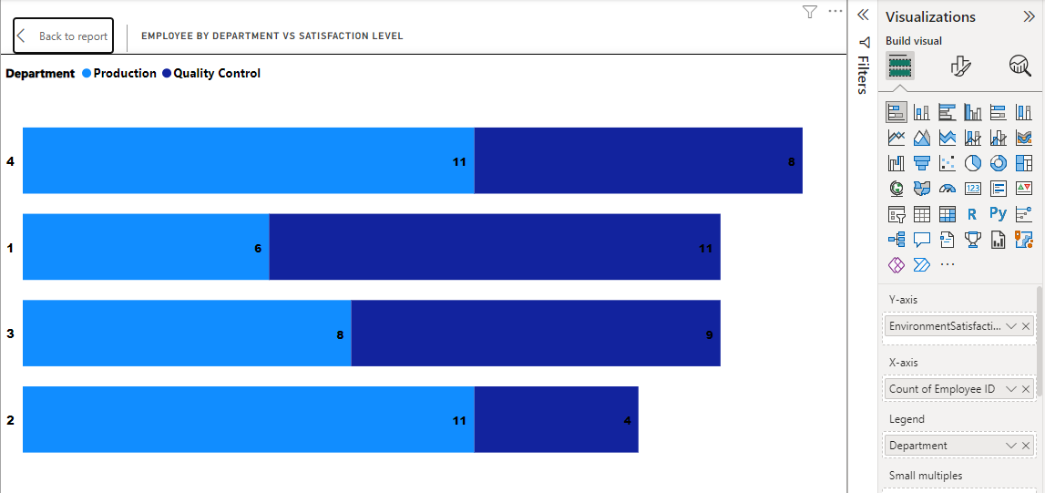
Employee by Department Vs Satisfaction Level
How we go this graph:
From the visualization tool we choose a stacked bar chart.
On the field section, click the IFAB to dropdown all the columns in the dataset.
Drag the employee ID fields to the X-axis, EmployeeSatisfaction on the Y-axis and Department on Legend area under the Visualization pane.
Click on the symbol beside the Build visual to format it to suit you.

Slide 19
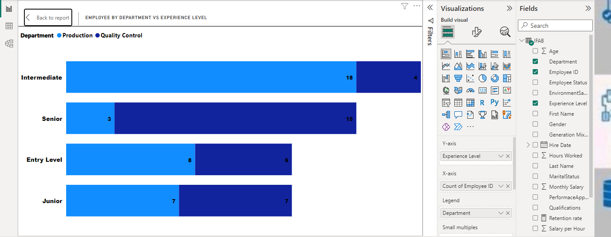
Employee By Department Vs Experience Level
From the visualization tool we choose a stacked bar chart.
On the field section, click the IFAB to dropdown all the columns in the dataset.
Drag the employee ID fields to the X-axis,Employee Level on the Y-axis,Department on Legend, on the area under the Visualization pane.
Click on the symbol beside the Build visual to format it to suit you.

Slide 20
Explaining each graph and what question it answer:
Questions:
Diversity and Inclusion: "Using Power BI, analyze and visualize workforce diversity data, showing the distribution of employees across gender and age. Include metrics on diversity ratios and visualize progress towards diversity and inclusion goals."
Why? Analyzing diversity and inclusion data with Power BI serves to visualize workforce demographics, including gender, marital status and age distribution. This approach provides insights into diversity ratios and tracks progress toward diversity and inclusion goals, enabling informed decision-making and a more inclusive workplace.
The next three slides will show the visualization of the question ask.

Slide 21
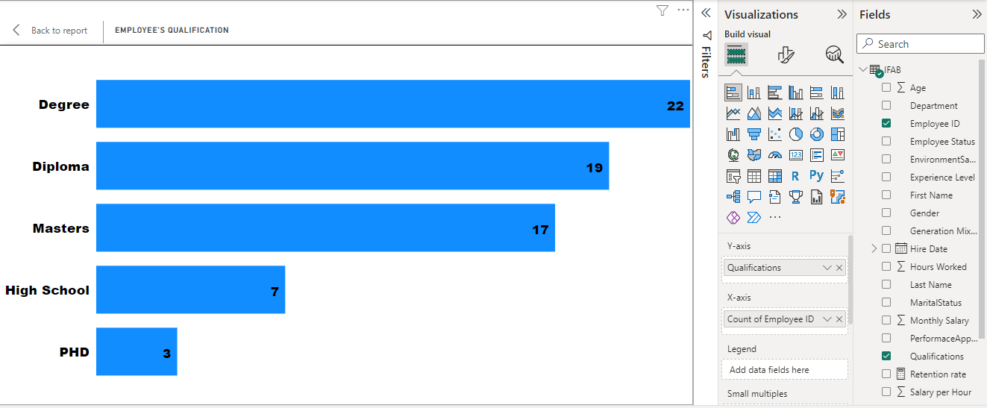
Employee Qualification
How we go this graph:
From the visualization tool we choose a stacked bar chart.
On the field section, click the IFAB to dropdown all the columns in the dataset.
Drag the employee ID fields to the X-axis, Qualification on the Y-axis, on the area under the Visualization pane.
Click on the symbol beside the Build visual to format it to suit you.

Slide 22
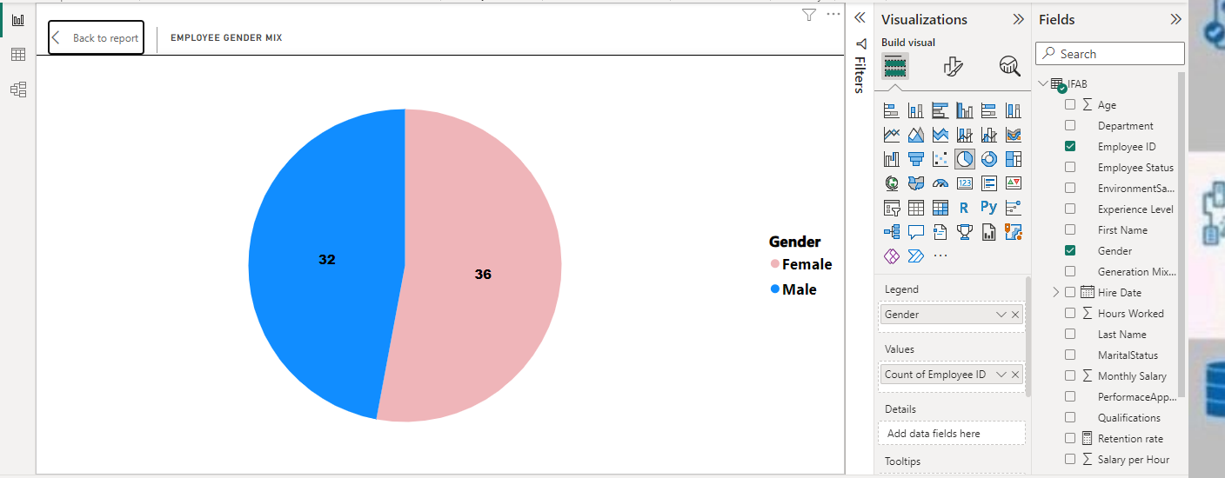
Employee Gender Mix
From the visualization tool we choose a Pie chart.
On the field section, click the IFAB to dropdown all the columns in the dataset.
Drag the Gender fields to the Legend, Count of Employee ID on values, on the area under the Visualization pane.
Click on the symbol beside the Build visual to format it to suit you.

Slide 23
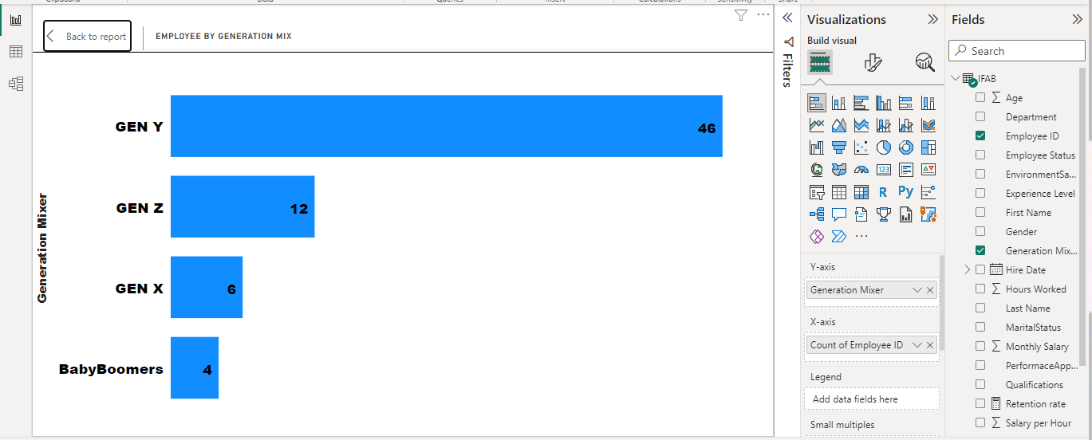
Employee By Generation Mix
From the visualization tool we choose a stacked bar chart.
On the field section, click the IFAB to dropdown all the columns in the dataset.
Drag the employee ID fields to the X-axis, Generation Mix on the Y-axis, on the area under the Visualization pane.
Click on the symbol beside the Build visual to format it to suit you.

Slide 24
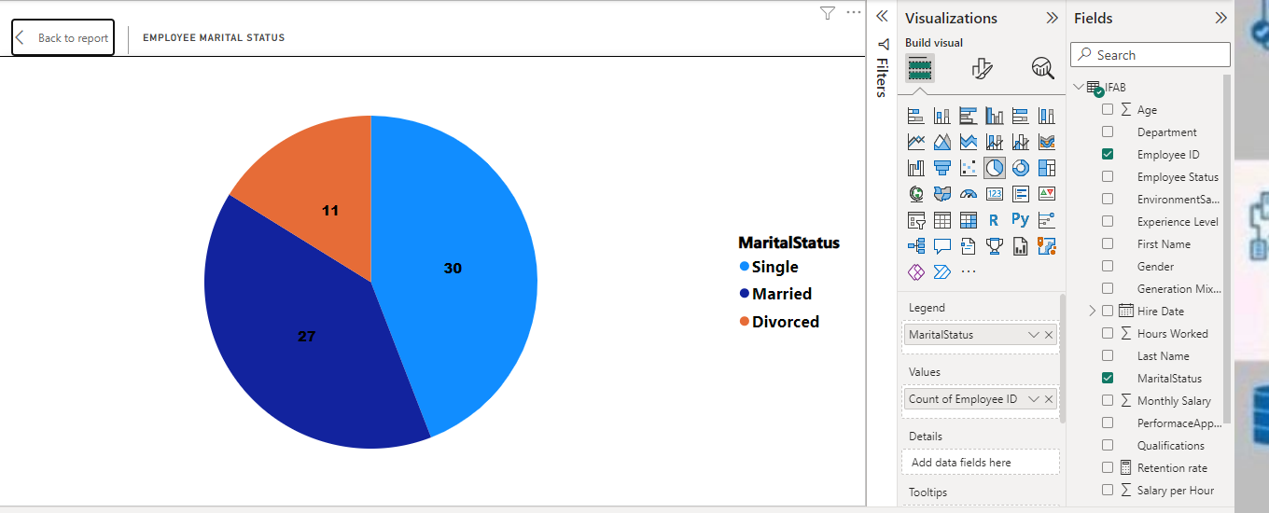
Employee Marital Status
How we go this graph:
From the visualization tool we choose a Pie chart.
On the field section, click the IFAB to dropdown all the columns in the dataset.
Drag the MaritalStatus fields to the Legend, Count of Employee ID on values, on the area under the Visualization pane.
Click on the symbol beside the Build visual to format it to suit you.

Slide 25
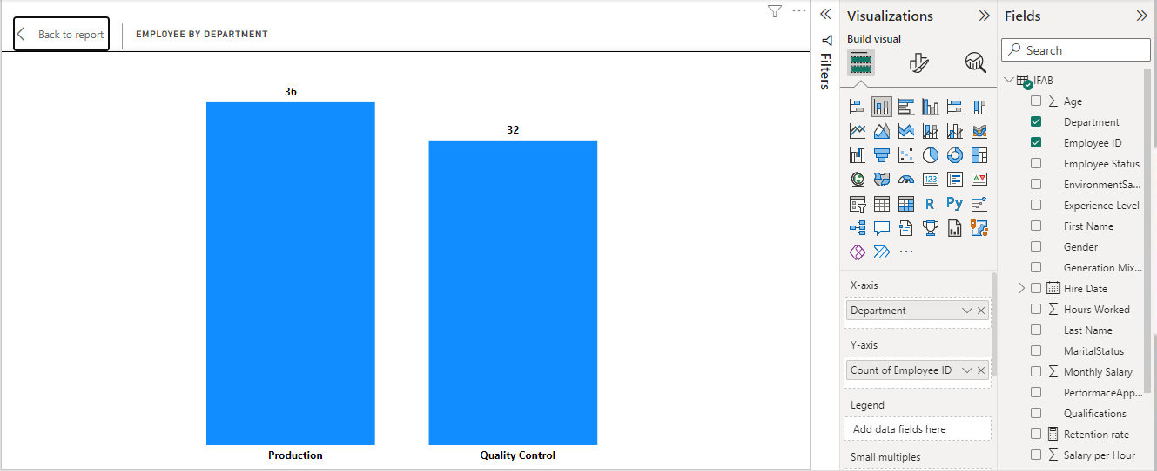
Employee By Department
How we go this graph:
From the visualization tool we choose a stacked bar chart.
On the field section, click the IFAB to dropdown all the columns in the dataset.
Drag the employee ID fields to the Y-axis, Department on the X-axis, on the area under the Visualization pane.
Click on the symbol beside the Build visual to format it to suit you.

Slide 26
Conclusions:
In summary, the goal of this project to be able to gather data for a data-driven solution that involves business intelligence (BI). This was possible by the use of Power Bi software tool. This enable me to create a BI system for monthly data input, which will accelerate our processes for tracking and measuring data. These initiatives are meant to improve our data management skills so that our organization can make better decisions.

Slide 27
Q & A

Slide 28
THANK YOU

